Slide 1

Cracking the Code:
Mastering Enterprise Context for Next-Gen Agentic AI
Team RAGonizers

Slide 2



CONTEXT
How decisions have evolved on the shopfloor over the years
Manual
With current systems
Context-Aware Agents
Supervisors rely on manuals
Knowledge lives in people
Context rebuilt every shift
Checks happen informally
Events are reported
Workflows follow static rules
Generic recommendations
History stored, not reasoned over
Decisions grounded in history
Policies are enforced
SOPs applied dynamically
Learning compounds over time
Outcome:
Slow, inconsistent, high risk-prone
Outcome:
Faster execution, limited judgement
Outcome:
Fast, safe, auditable
Notes:
This is the jump that matters for enterprise adoption.

Slide 3
PROBLEM STATEMENT UNDERSTANDING
AI agents fail to reason, retain, and use enterprise context:
business rules
historical decisions
policies
permissions
because:
Context spans
multiple systems
Permissions change by
role and time
1
2
3
4
Decisions depend on
history, not just data
Workflow spans shifts,
systems, and people
Notes:
Why this is hard in enterprises
Lack of data problem
Context engineering problem.

Slide 4
RESEARCH
The cost of context failure:
$2.1 Mn
Safety risks escalate
Operational failures
annual productivity loss per enterprise
from manual intervention caused
by fragmented context
Agents misinterpret
compliance rules and authorisation boundaries
Loss of long-running process state causes workflow breakdowns
THE REAL GAP
Goal drift mid-execution
Governance gaps
Agents forget mid-
execution, leading to
incomplete tasks
Inability to operate within regulatory frameworks creates liability
isnt lack of AI models or computing power
because technology continues to improve.
Enterprises are missing something fundamental.

Slide 5
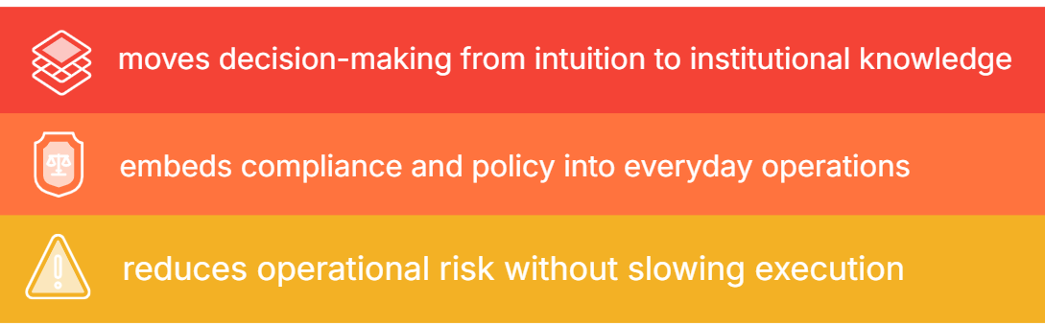
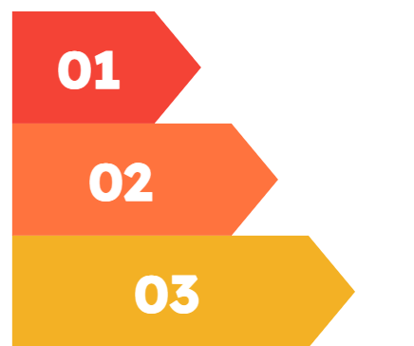
Business value at scale
$450 - $650 Bn
expected annual revenue from
agentic AI by 2030
Enterprise benefits
30-50%
Fewer interventions & rework
cost savings from
task automation &
operational streamlining
Faster, consistent, and
reasoned decisions
Critical knowledge retained
beyond individual engineers
Notes:
If enterprise context is made persistent, structured, and governed,
AI agents can reason safely and operate reliably in regulated environments.

Slide 6

Why Manufacturing as a context stress test?
decisions are safety-critical
permissions are tightly governed
SOPs are non-negotiable
errors have immediate cost
Context errors are visible,
not theoretical.
USE CASE: Maintainence of automotive manufacturing machinery
A single maintenance decision requires:
past interventions
current certifications
applicable SOPs
policy boundaries
No single system holds this together.
Humans understand. Agents cannot.

Slide 7
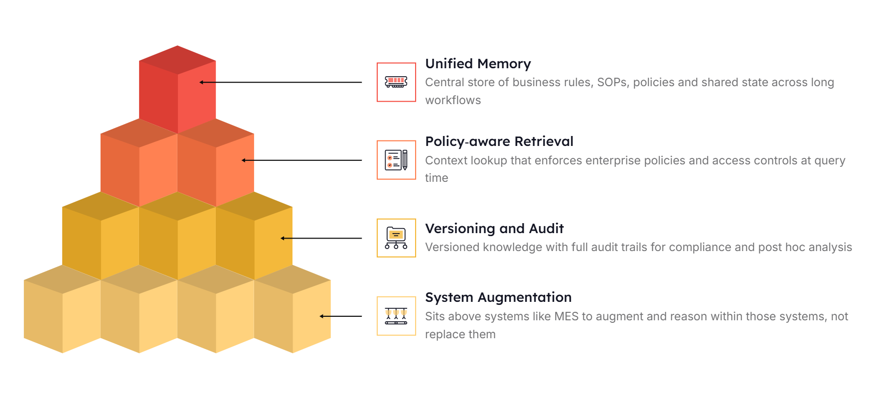
Solution overview:
Notes:
If enterprise context is made persistent, structured, and governed,
AI agents can reason safely and operate reliably in regulated environments.

Slide 8
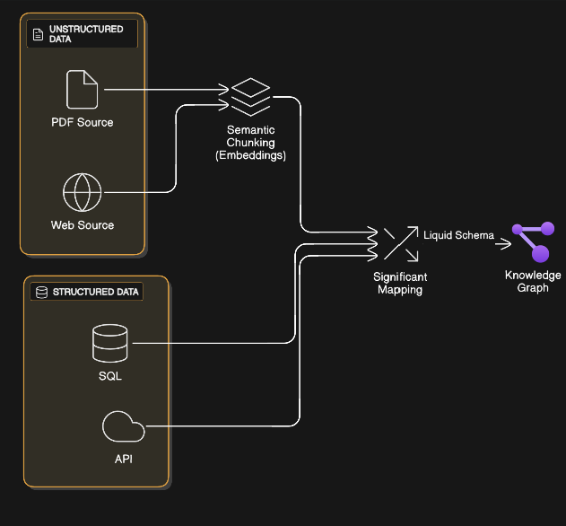
Ingestion flow

Slide 9
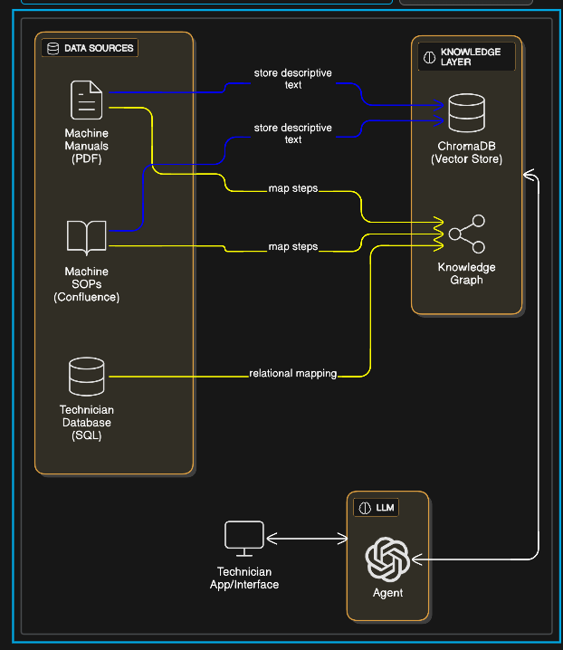
Unified intelligence assistant

Slide 10
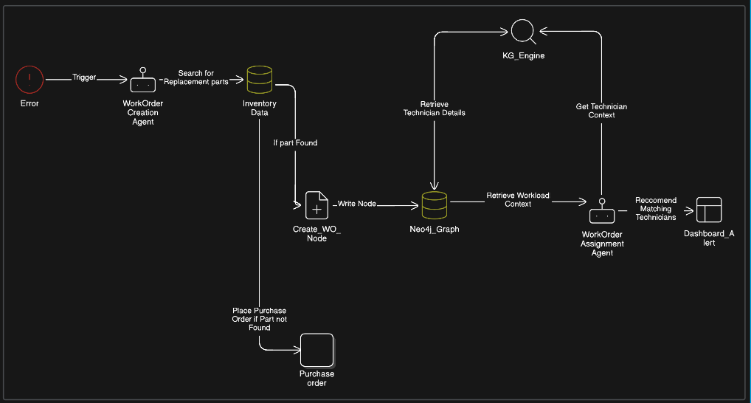
Target state architecture

Slide 11
ROADMAP FOR PRODUCTION SCALING:
Phase 1: Foundation
(1-3 months)
Phase 3: Scale
(7-12 months)
Deploy unified memory layer
Multi-facility expansion
Integrate core data sources
Expand to additional use cases
Establish governance framework
Performance tuned
1
2
3
4
Phase 2: Pilot
(4-6 months)
Phase 4: Enterprise
(13-18 months)
Single-facility prototype
Production-wide adoption
Train agents on maintenance workflows
Cross-domain integration
Validate compliance mechanisms
Continuous learning
Key dependencies include data quality, change management, and API availability.
Mitigation strategies include phased rollouts, stakeholder engagement, and redundant data pipelines.

Slide 12




Business Impact Assessment
Operational Excellence
Safety & Compliance
Scalability & ROI
67% reduction in unplanned downtime
100% adherence to certification requirements
Solution scales across multiple facilities
45% faster mean time to repair
£1.8M annual savings per plant
Real-time compliance monitoring
Automated audit trails
23% improvement in asset utilisation
Proactive risk identification
Value Proposition: Our unified context approach transforms manufacturing operations, enabling safe autonomous agents that understand enterprise complexity and deliver measurable business outcomes.

